Slide 1
Kubernetes with Red Hat OpenShift Workshop
Live Virtual Event – April 21 2020
—
Dewan Ahmed, Developer Advocate
Steve Martinelli, STSM, Developer Advocate
Notes:
1

Slide 2
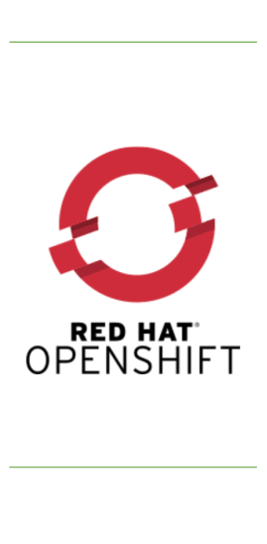
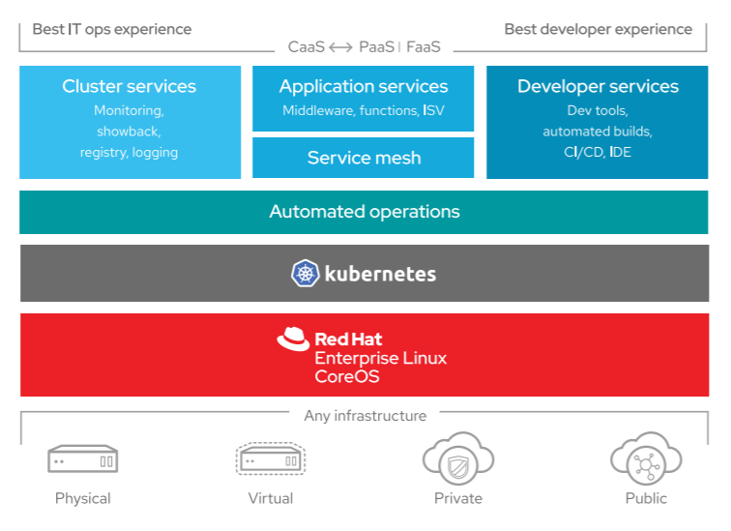
Open-source | Secure | Fully certified | Portable
#IBMDeveloper

Slide 3
Open Source
Secure by default
Developers and Administrators
Runs everywhere
https://cloud.ibm.com/docs/openshift
#IBMDeveloper

Slide 4

Call for Code 2020
Global Code for Good initiative IBM is part of
Take on Covid-19 or Climate Change
https://developer.ibm.com/callforcode/

